Slide 1
Financial Programming Professor: Minh Phan
Student: Philipp Borchert
Financials US

Slide 2
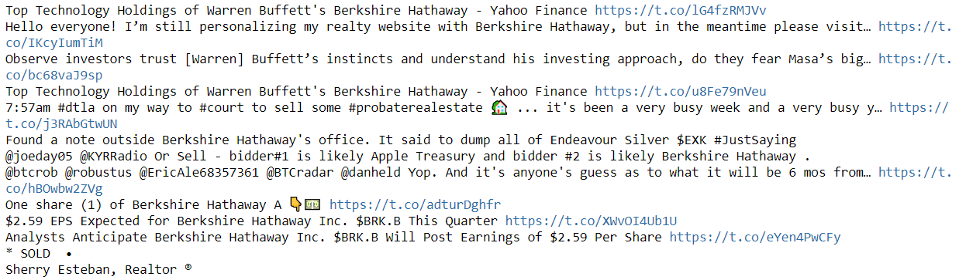
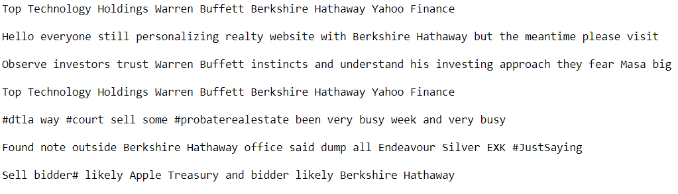
Twitter Data
Remove Duplicates
Clean Text
Tokenize

Slide 3
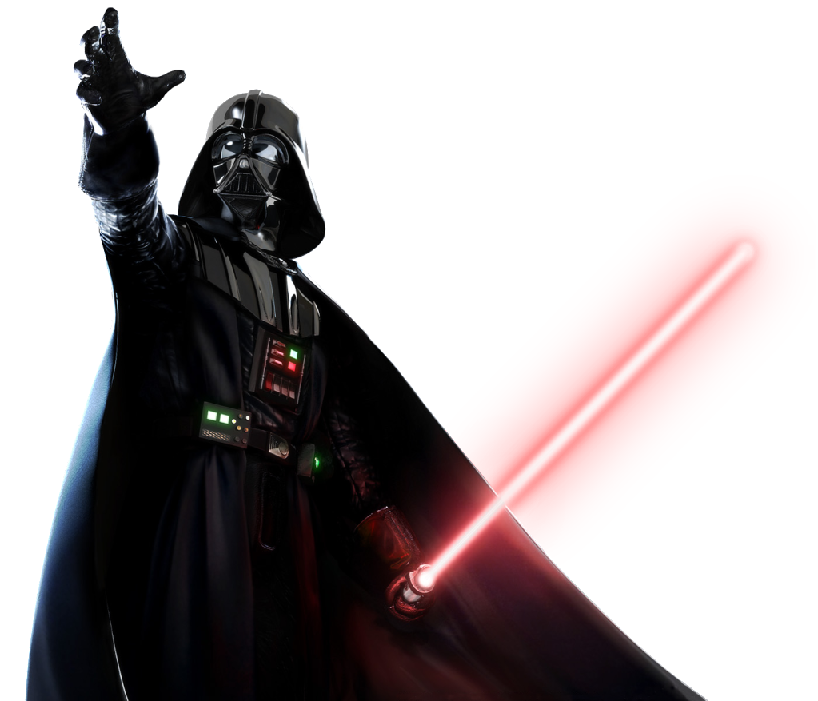


Sentiment Analysis
NLTK Vader Package
Social Media
Trained on cinema reviews
Scale [-1 : 1]

Slide 4
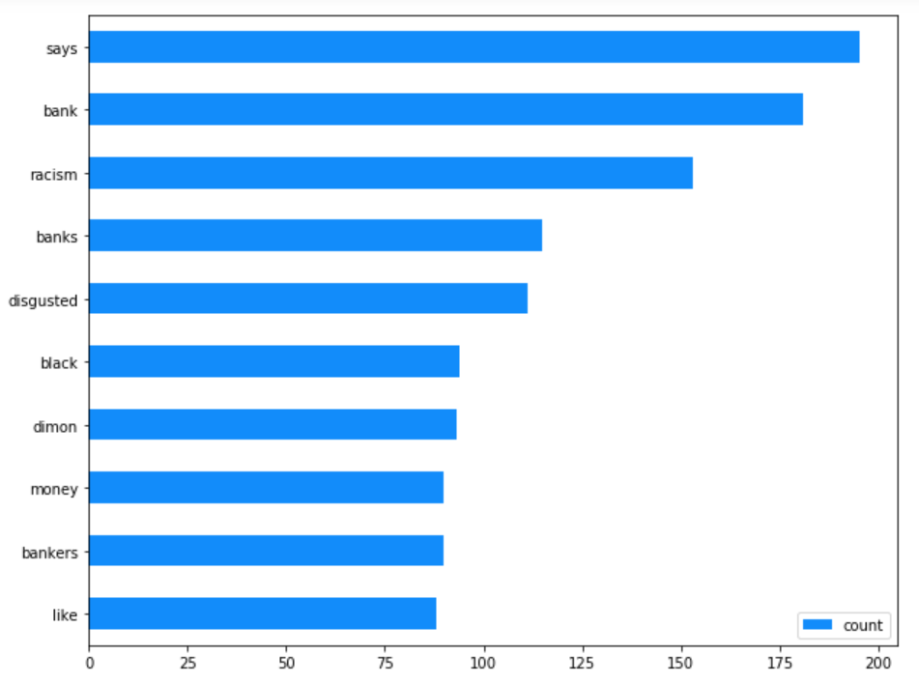
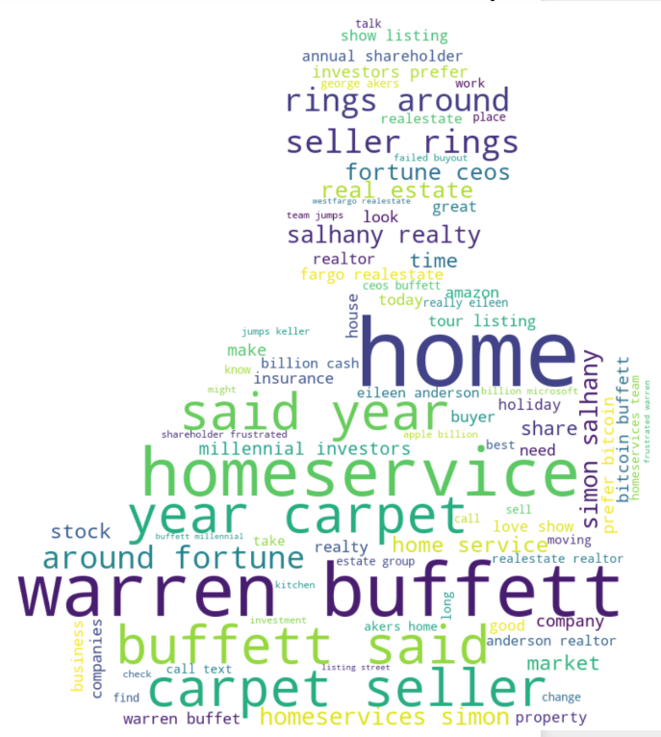
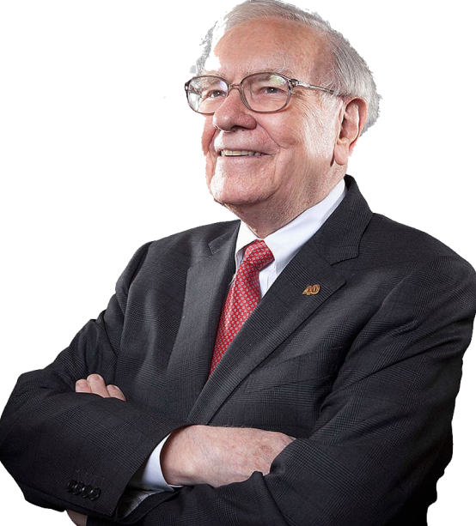
Berkshire Hathaway

Slide 5
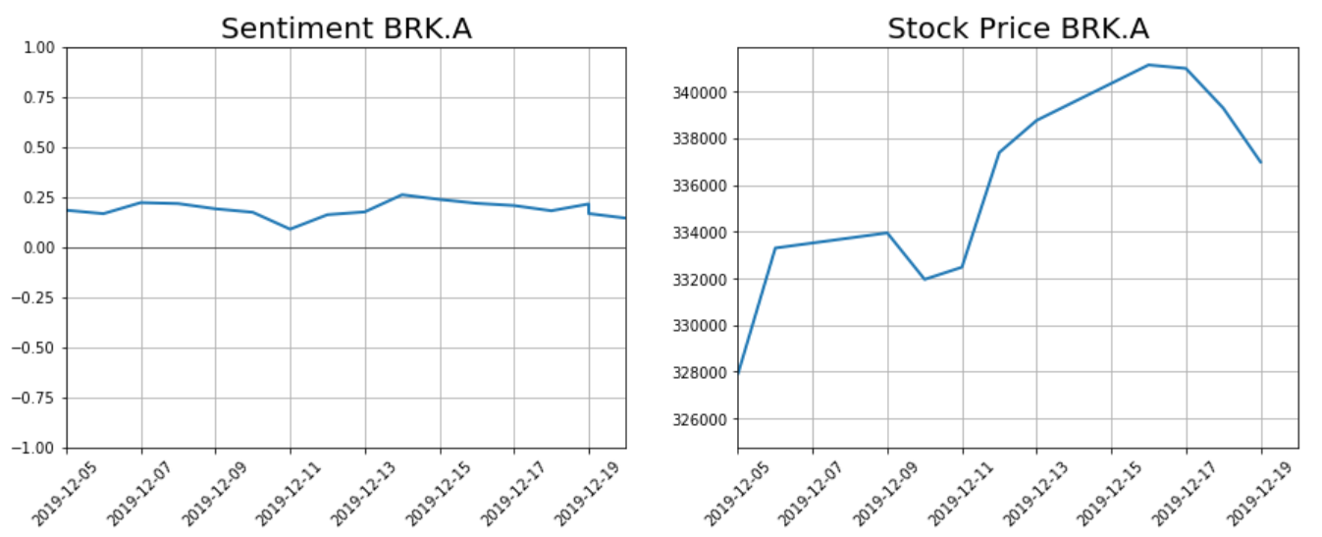

Slide 6

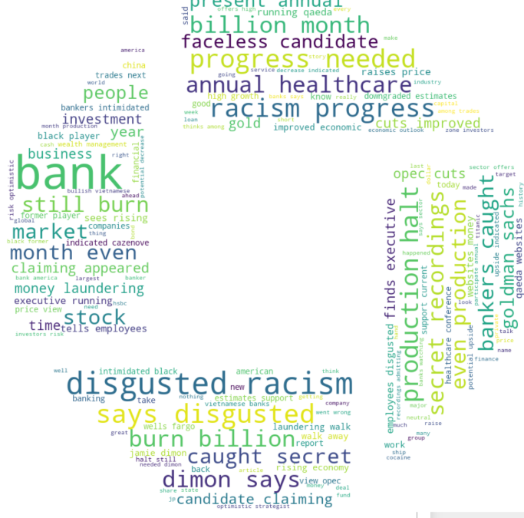
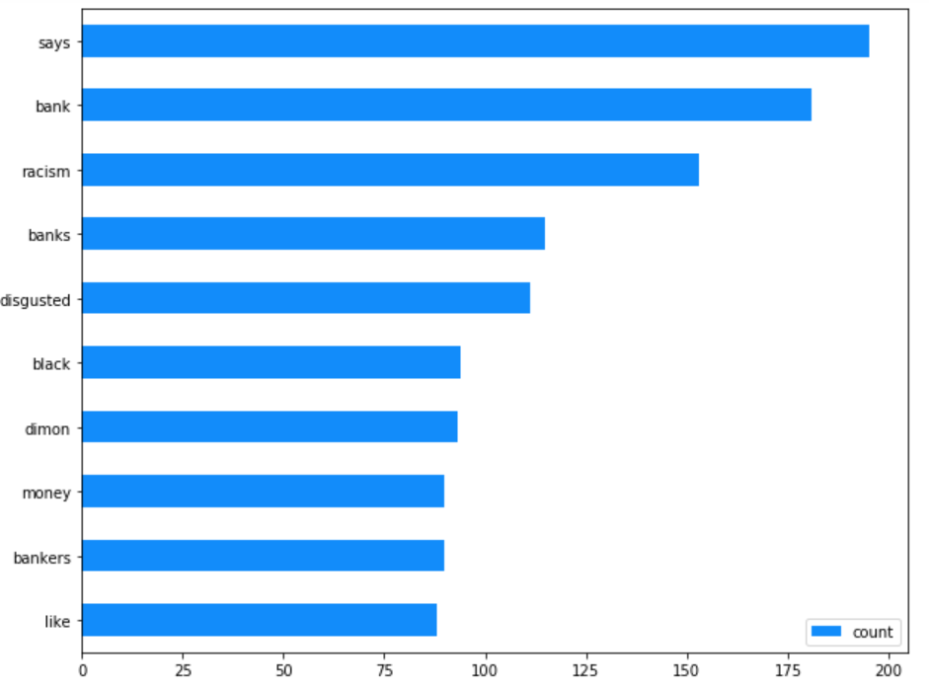
JP Morgan (Chase)

Slide 7
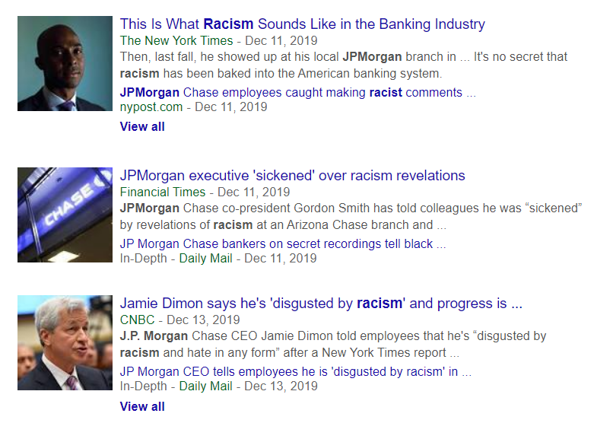

Slide 8
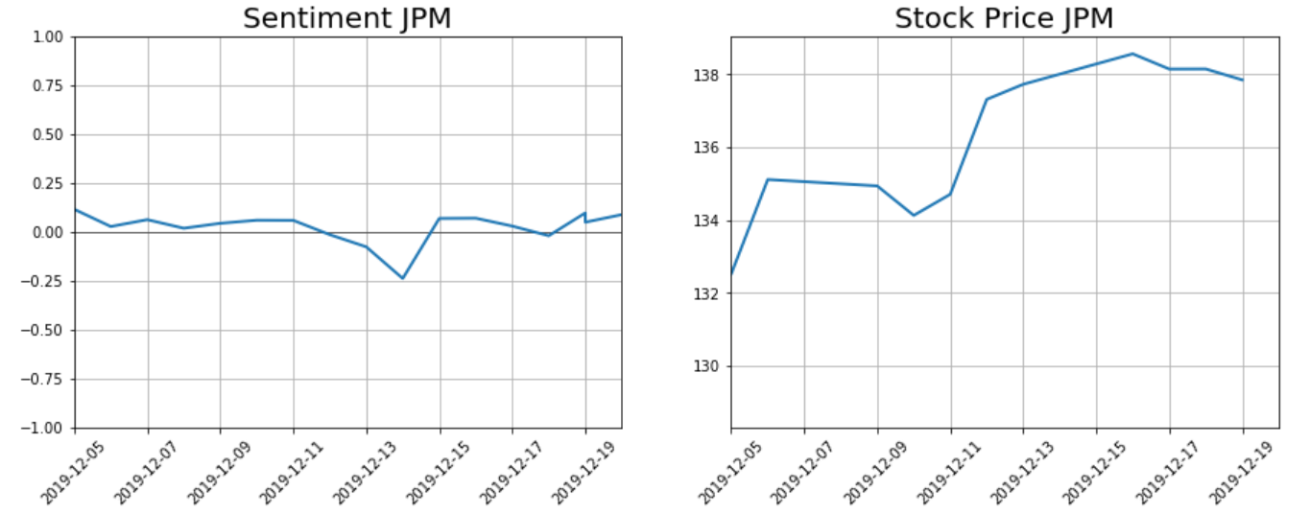

Slide 9
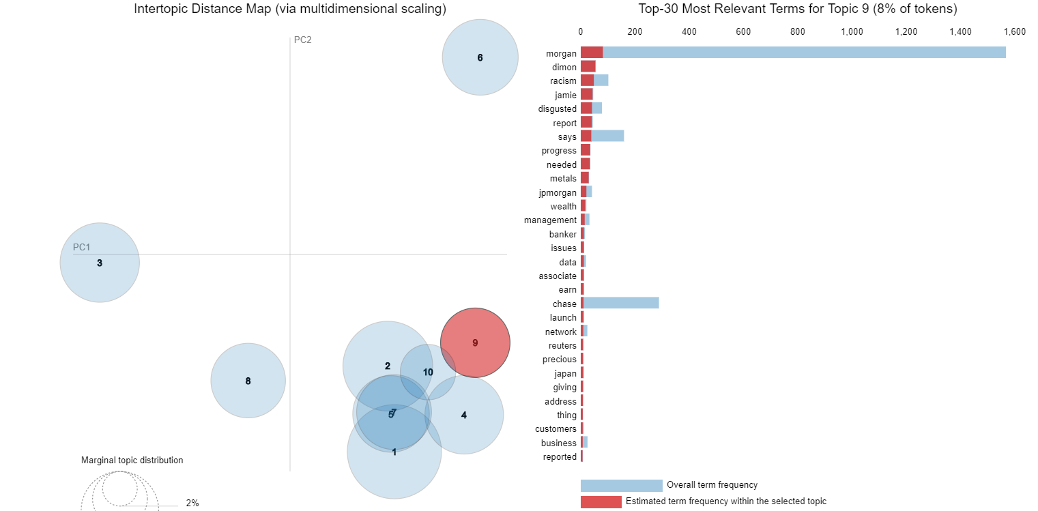
Intertopic Distance Map

Slide 10

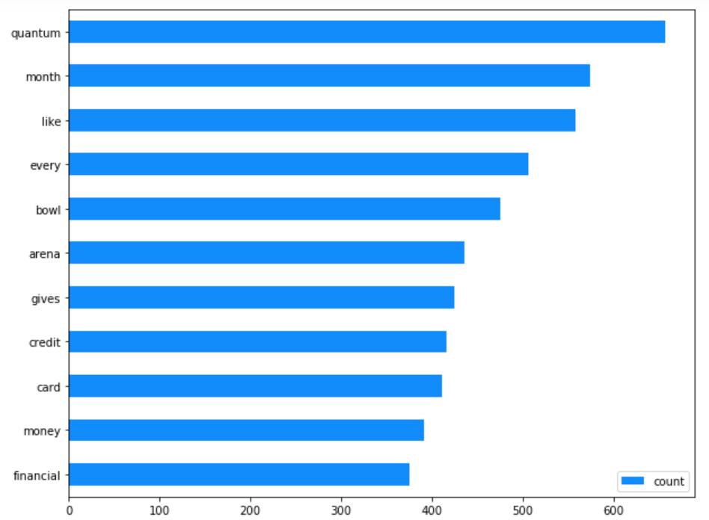
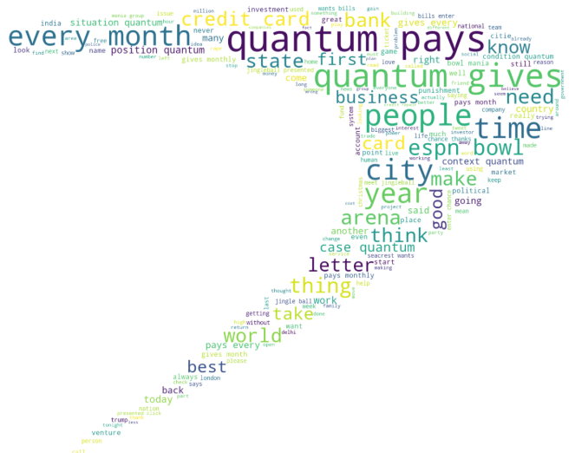
Capital One

Slide 11
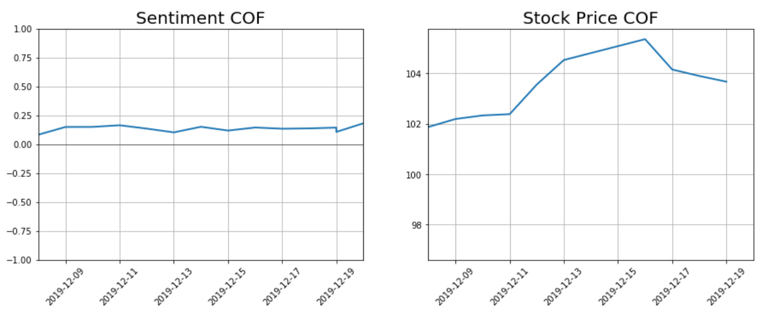

Slide 12

Conclusion & Remarks
NLTK Vader general sentiment scoring
Train Classification Model (Naïve Bayes, Logistic Regression, etc.)
Twitter as communication channel for Financial companies?
No major movement in stock prices
Short Period (2 weeks)

Slide 13
Thank you!

